Slide 1

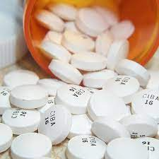
IP Calculation
Presenters:-Sonal Takarkhede & arti yadgire

Slide 2
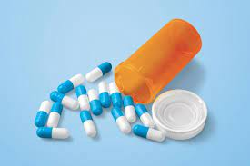
Contents
Introduction
Importance
Examples
Calculate study drug compliance.
Other compliance considerations.
Discrepancy
References

Slide 3
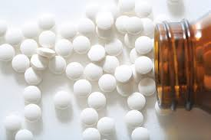
Introduction
An investigational product refers to a preventative (vaccine), a therapeutic (drug or biologic), device, diagnostic, or palliative used in a clinical trial.
An investigational product may be an unlicensed product or a licensed product when used or assembled (formulated or packaged) differently from the approved form, when used for an unapproved indication, or when used to gain further information about an approved use.

Slide 4
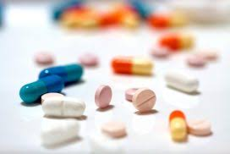
Importance
Testing IP on human subjects validates dosage and safety.
During most phases of clinical studies, the IP is evaluated for efficacy and safety in human subjects.

Slide 5
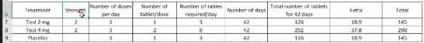
Examples(1/2)
Calculation of IP for the study based on following:
Treatment arms: 3 (Test 2 mg, Test 4 mg and placebo)
Strength of Test: 2 mg
Dose: to be taken 3 times a day
Treatment duration: 6 weeks

Slide 6
Example(2/2)
e.g. patient took first pill in September 1st and last pill on October 1st, told total 3 a day and was given 100 pills - patient returned 7 pills at next visit sep 1 to oct 31 = 31 days 31x3 = 93 patient returned 7 pills (100-7=93) 93(taken by patient as 100-7 =93) divided by 93(assumed take by patient)=a a x 100 = 100%

Slide 7
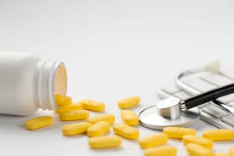
Calculate study drug compliance
Taking the amount of drug ingested divided by the amount the patient should have ingested and multiply by 100
Check medication and record of no. of pills returned in container
Record patient's first pill and date and last pill etc.

Slide 8
Other compliance considerations
e.g. if the patient returned 12 pills at the next visit there is still 31 days between doctor visits so you subtract 12 from 100 which gives you 88 therefore, 88 divided by 93 times 100 make the patient's compliance 94.62%

Slide 9
Discrepancy
If the numbers don't add up to 100, you must write an explanation for the clinical study drug
If a subject did not return the medication for you to that the medicine bottle is either empty or have a certain number of pills remaining, compliance cannot be accurately determined. Without that container, you have no means of verifying compliance. You can document what the subject said in their documents, but refer to the sponsor to determine if they want you to calculate compliance without verification.

Slide 10
References
Flashcards Calculating clinical study drug compliance and acountability | Quizlet
https://www.ncbi.nlm.nih.gov/pmc/articles/PMC3148614/

Slide 11
Thank You

